Slide 1
Automated Verification
of Network Function Binaries
Solal Pirelli,
Akvilė Valentukonytė, Katerina Argyraki, George Candea

Slide 2

Context
e.g., IEEE 802.1D
Notes:
Crush, bugs, specification

Slide 3
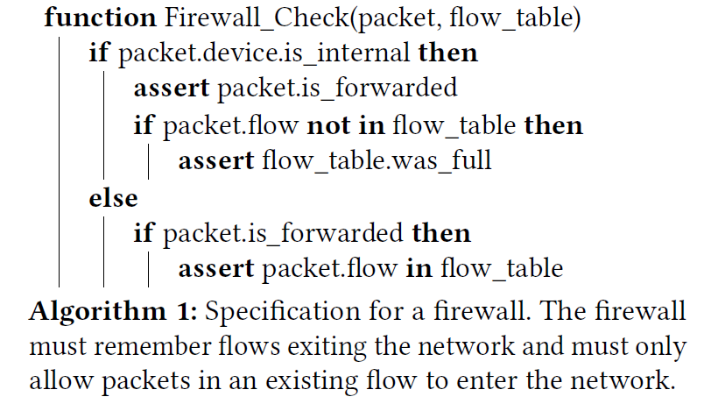
Specification

Slide 4
Network Functions
NF code
Data structures
Too complex for automated verification
Beyond the scope of this paper

Slide 5
Requirements
Vigor SOSP’19 | Gravel NSDI’20 | This work
◐ | ◐ | ●
◌ | ◌ | ●
NFs need automated verification, but:
Developers use many data structures
Operators deploy binaries

Slide 6
Network Functions
Restrict the design to network functions
Use mutable state to process packets
Contain two phase
initialization
packet processing
Network functions uses data structures in a modular fashion
Network functions should not allocate memory while processing packets
Avoid performance issues
Avoid out-of-memory errors

Slide 7
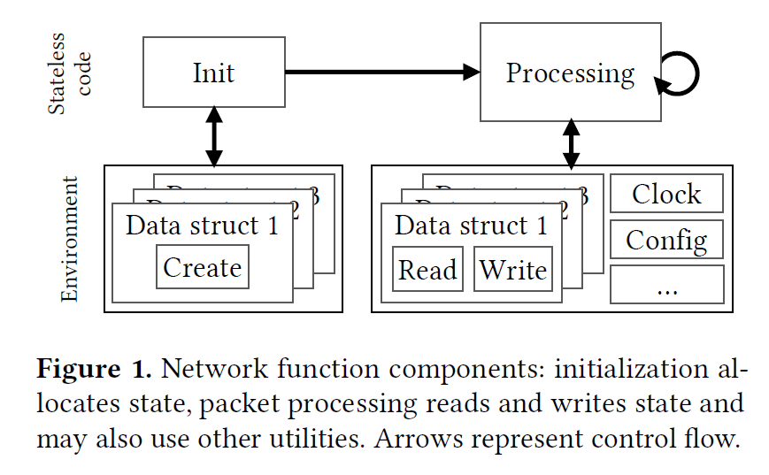
Network functions

Slide 8
Hard part
Translate data structure operations to map operations
Contracts
Flow table
Hash map
NF code
Cache
Array
…
Automatically prove the code obeys contracts by inferring the necessary invariants

Slide 9
Overview of KLINT
Input: Network function binary, Python specification, contracts
Identify all environment interactions
Environment
Map interaction operations to contracts
Function calls
Symbolically execute contracts
Symbolically execute NF’s initialization code
Data structures
Symbolically execute packet-processing code
Symbolic execution
Satisfy specification?

Slide 10
Symbolic execution
Analyze a program to determine what inputs cause each part of a program to execute
Find bugs
Symbolic execution generalizes testing
Logical formula
Satisfiability Modulo Theories (SMT) solver
Determine whether a mathematical formula is satisfiable

Slide 11
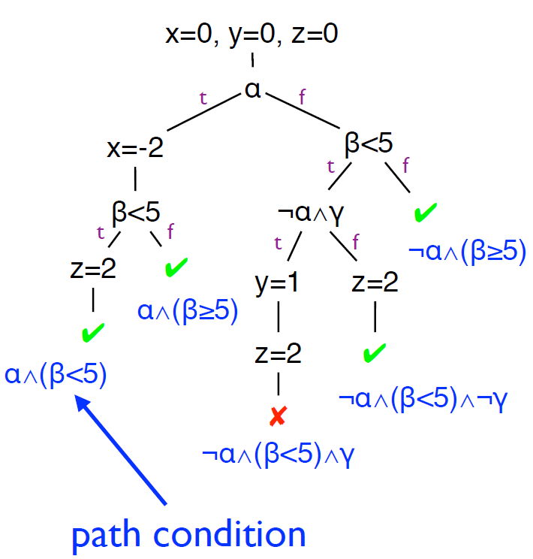

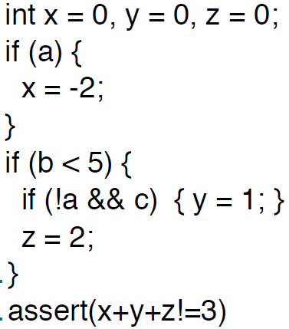


Symbolic execution
$a=1,b=2,c=−1$
$x=−2,z=2,y=0$
Logical formula

Slide 12
Symbolic execution
Satisfying assignment
SMT
Logic Formula
UNSAT
Z3, STP, and Yices

Slide 13
Describing data structures with maps
enables the automated verification of network function binaries

Slide 14
Outline
Intro
Abstracting data structures
Handling binaries Implementation Evaluation & Limitations

Slide 15
Map
Map
Map
Map

Slide 16
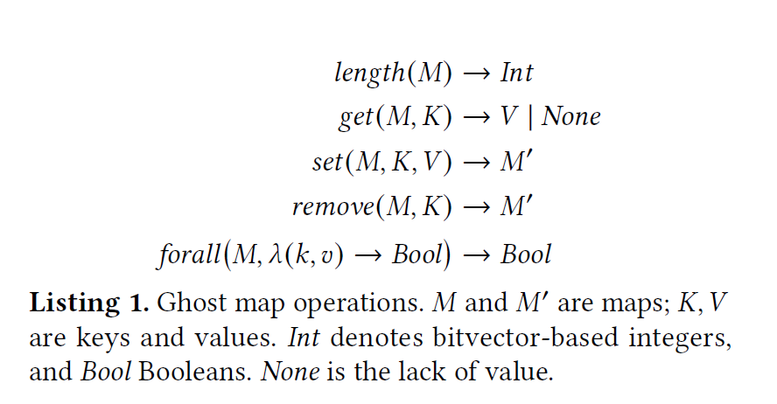
Ghost map operations

Slide 17
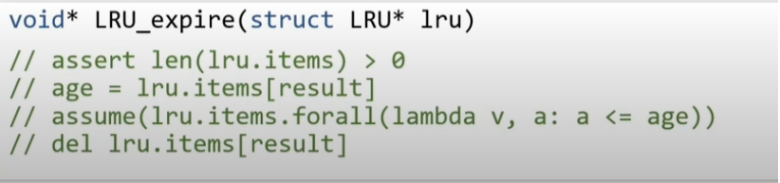
Contract example: LRU.evict()
State: map M (value → age)
Pre: M.length() > 0
Post:
M.contains(result)^
M’=M.remove(result)^
$$∀\left(v,a\right)∈M:a≤M.get(result)$$

Slide 18
Translation
Map operations → decidable solver queries
Problem: map size is unknown
Insight: few operations per packet

Slide 19
Translation
Track known items explicitly,
and unknown items as an invariant
V₁ = get(M, K₁)
( K₁, V₁, present )
( K₂, _, absent )
remove(M, K₂)
others: λk,v,p. …

Slide 20
Translation
Use known items as templates to form invariant candidates:
“Values in M are > X”
“Values in M₁ are keys in M₂”
…

Slide 21
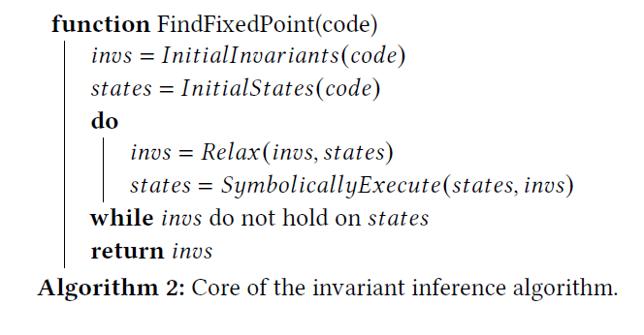
Invariant inference
Developers use data structures in well-defined patterns (invariants)
not always explicit in the code
Example: The initial invariant
“the firewall’s flow_table is always empty” could be
relaxed into “the flow_table may have items, and its length is always the same as the statistics”.
converge

Slide 22
Symbolic execution
Now all is map operations
Logical formula

Slide 23
Outline
Intro
Abstracting data structures
Handling binaries Implementation Evaluation & Limitations

Slide 24
Network Functions
Data structures
NF code

Slide 25
Source code
Data structures
Network primitives

Slide 26
Exhaustive symbolic execution
pkt_is_ipv4 ∧ … !pkt_is_ipv4 ∧ …
…
…

Slide 27
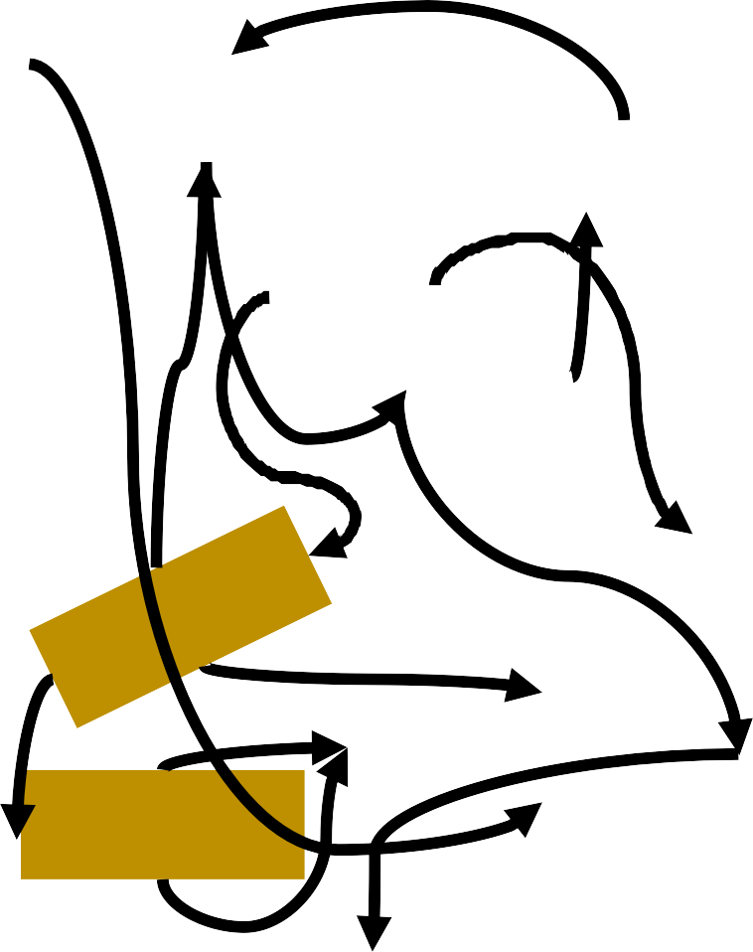
Binaries
map_get(.
map_
get
..)
Data structures
Data struct 1
Network primitives
Dynamic linking
17

Slide 28
Outline
Intro
Abstracting data structures
Handling binaries Implementation Evaluation & Limitations

Slide 29



Klint
angr
Contracts
NF binary
Invariant inference
Translation
Data structs
Spec
Verification
V
e
rificatio
n
Paths

Slide 30
Outline
Intro
Abstracting data structures
Handling binaries Implementation Evaluation & Limitations

Slide 31
Verified NFs
C:
Bridge Firewall Maglev NAT
Policer Router
Rust:
Policer

Slide 32
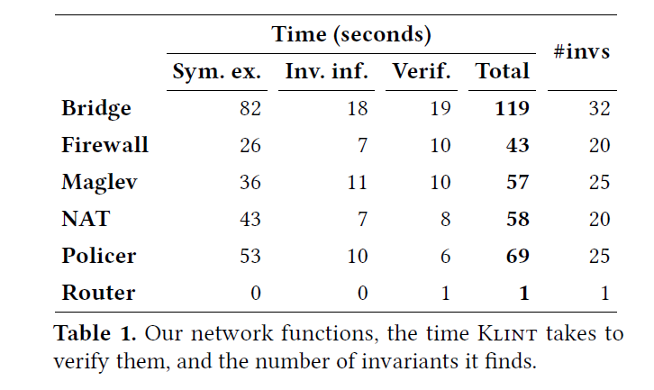
Verification performance
< 2 min / NF Single-threaded prototype

Slide 33
Verified NF performance
Prototyping new data structures is now quick (then verify manually, as previous work)
Faster than previous verified NFs

Slide 34
Why only NFs?
Few and shallow “networking” operations
Explicitly modeled by our tool
Not feasible for e.g. Linux

Slide 35
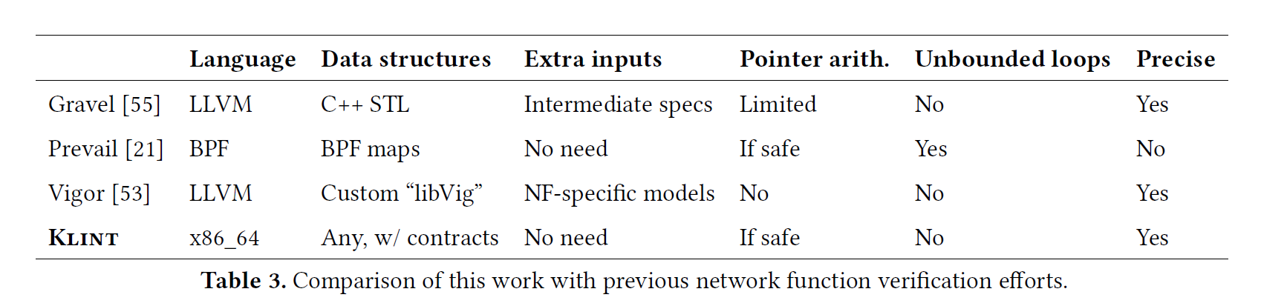
Applicability

Slide 36
Map limitations
Good fit for most data structures
Not applicable to all complex code: regex, ...
Klint cannot handle multi-threaded NFs

Slide 37
Summary
We verify network function binaries
that use any data structure with map-based contracts
We translate maps by separating known/unknown items, which scales and enables invariant inference
dslab.epfl.ch/research/klint
solal.pirelli@epfl.ch

Slide 38
Takeaways
Symbolic execution for NF verification!!!

Slide 39
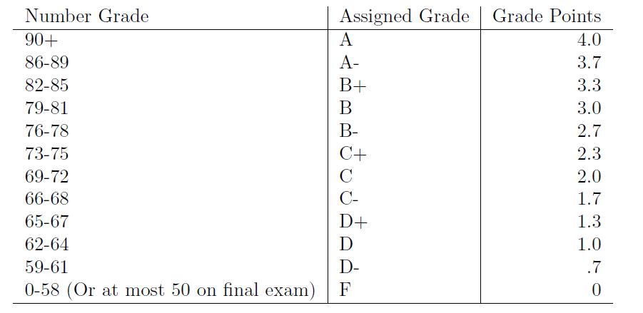
Grading Scale

